Slide 1



LOAN APPROVAL PREDICTION
PRESENTED BY:
KINJAL GOHIL

Slide 2

INTRODUCTION
Loan approval is often slow and subjective, relying on manual assessments. Using machine learning.
This system automates loan decisions based on key financial and personal factors, improving accuracy, speed, and fairness while ensuring consistent and data-driven outcomes.

Slide 3
AGENDA
01
02
03
04
PROCESS OVERVIEW
DATA ANALYSIS
Brief of Summary
Performing EDA
MODEL DEVELOPMENT
RESULT EVALUATION
Building and Training a Machine Learning Model to Predict Loan Approvals.
Assessing Model Accuracy and Performance on Loan Predictions.

Slide 4



01
PROCESS OVERVIEW

Slide 5
The loan approval process starts with collecting and understanding historical applicant data, including demographic, financial, and credit-related information.
This data is then cleaned and pre-processed, handling missing values and encoding features for machine learning.
Next, a predictive model is trained using this data to learn patterns that influence loan approval decisions.
Finally, the model is tested, evaluated, and deployed, enabling automated, fast, and objective loan approval predictions while reducing human bias and improving efficiency.

Slide 6
MISSION & VISION
MISSION
VISION
To make loan approvals efficient, accurate, and fair.
To build an automated, scalable, and transparent loan approval system.

Slide 7


ABOUT THE PROJECT
Automates loan approval using machine learning.
Analyzes demographic, financial, and credit-related factors.
Reduces human bias and speeds up decision-making.
Ensures consistent, fair, and data-driven approvals.
Handles missing or incomplete applicant information.
Scalable solution for large volumes of loan applications.

Slide 8



DATA ANALYSIS
02

Slide 9
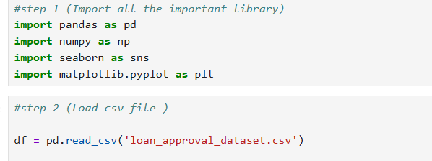
PHASE I
Let’s call all the essential library to perform commands.
Load the Dataset csv file.

Slide 10
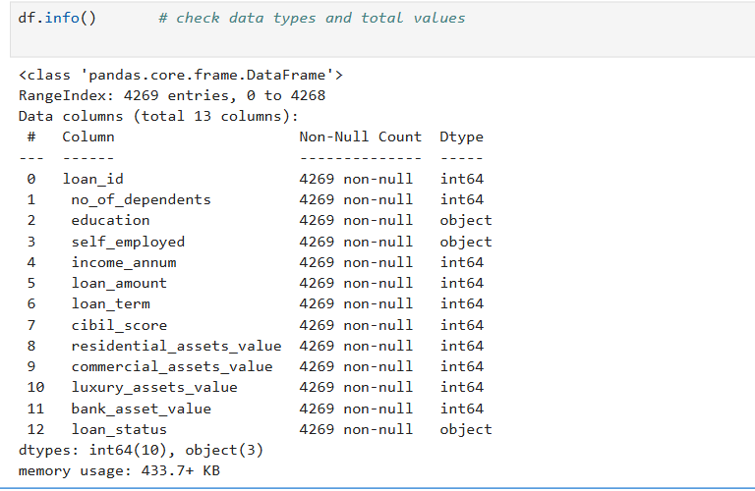
Checking the data types to ensure all columns function as intended..

Slide 11
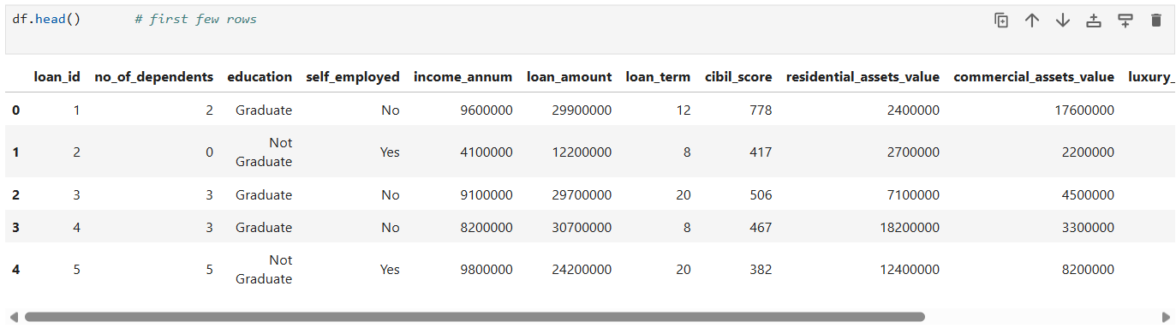
Checking that all data has loaded properly by retrieving five rows from the dataset.

Slide 12
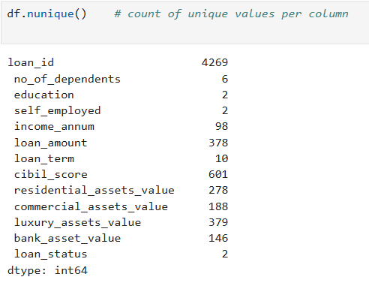
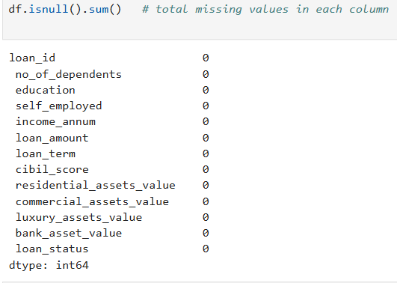
UNIQUE VALUES
MISSING / NULL VALUES

Slide 13
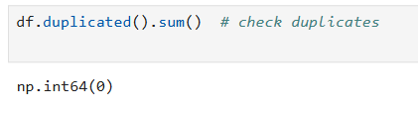
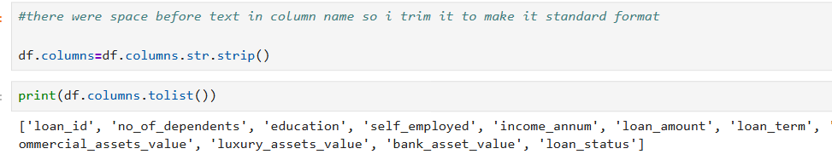
There are No Duplicate Values in Dataset

Slide 14
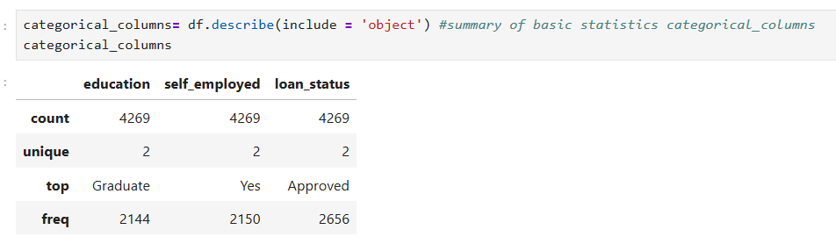
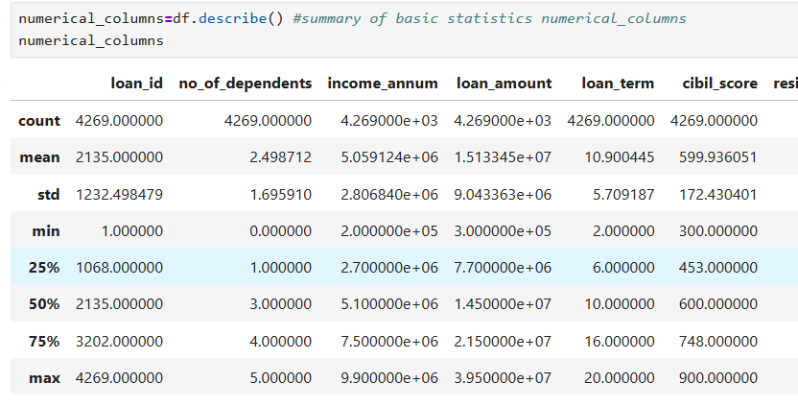
Classified Columns as Categorical or Numerical

Slide 15
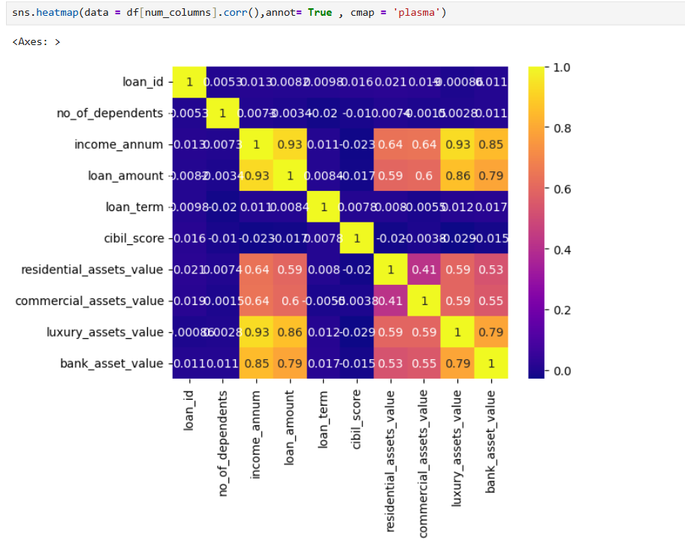
Created a Heatmap of Numeric Columns to Visualize the Correlations Between Them

Slide 16
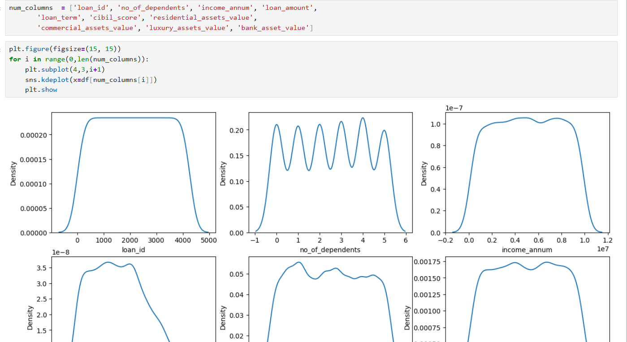

Slide 17
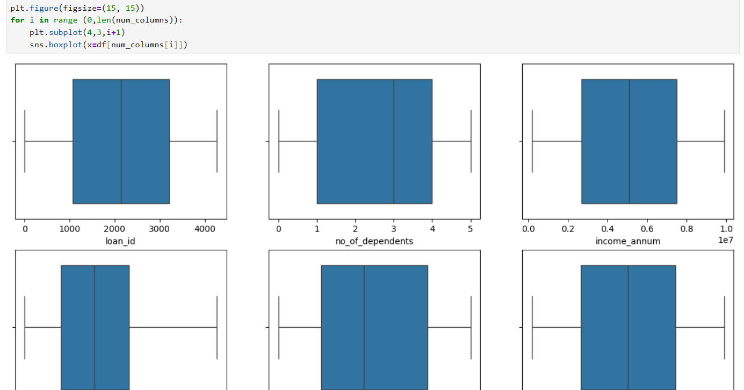

Slide 18
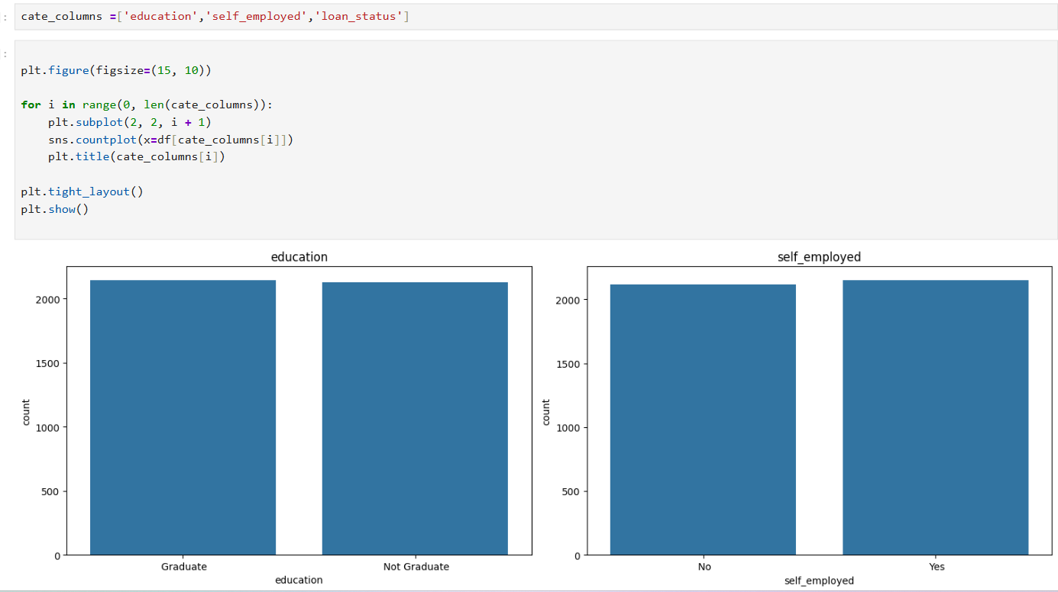

Slide 19
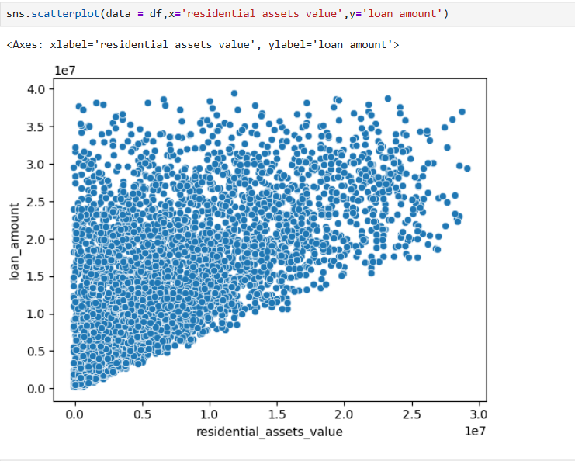
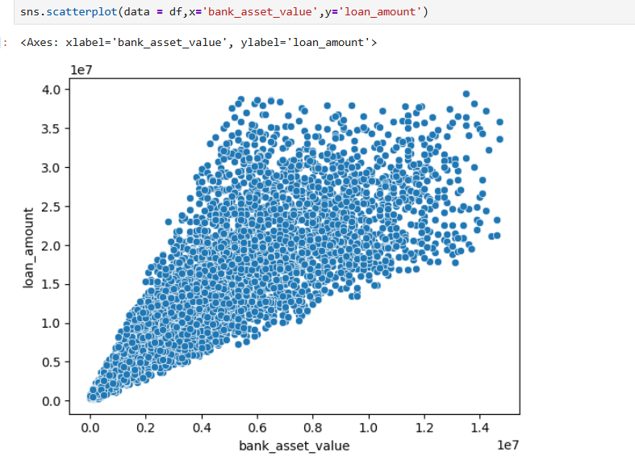
BIVARIATE ANALYSIS

Slide 20
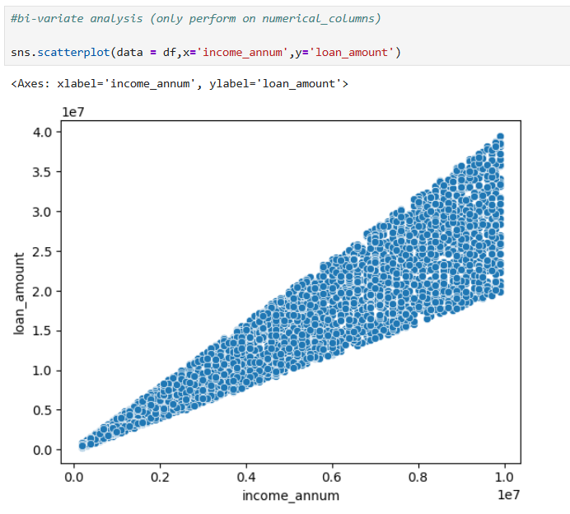

Slide 21
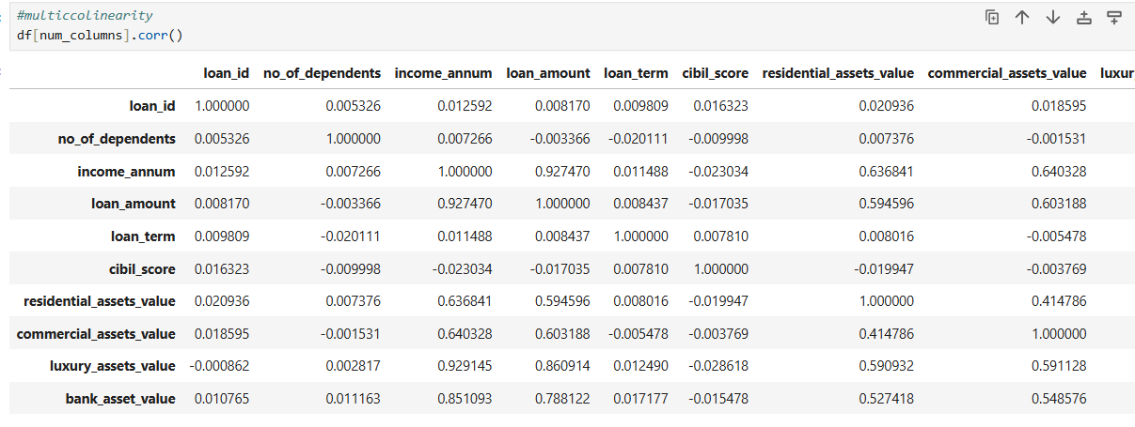
MULTICOLLINEARITY

Slide 22
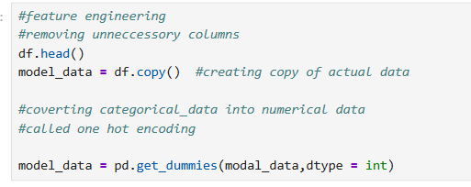
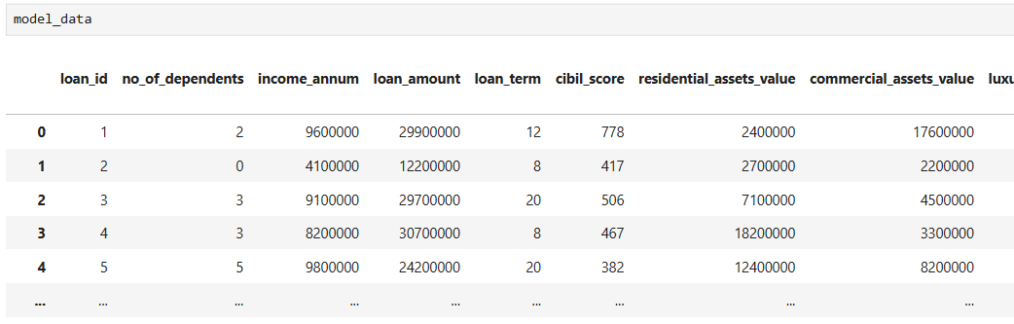
PHASE II
FEATURE ENGINEERING

Slide 23
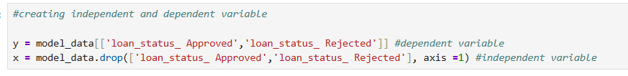
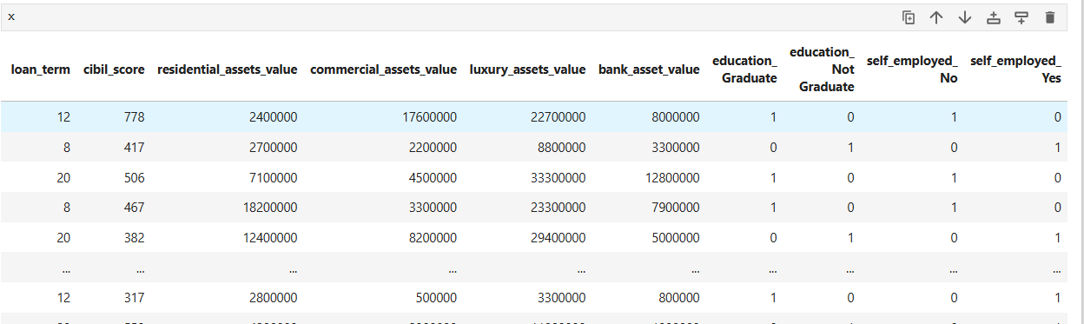
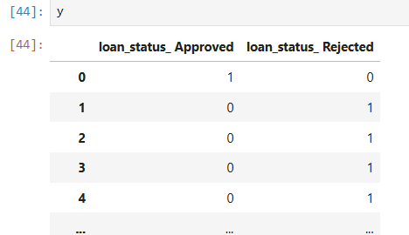

Slide 24

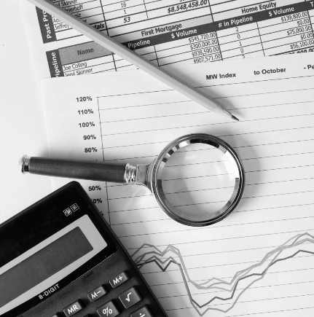

MODEL DEVELOPMENT
03

Slide 25
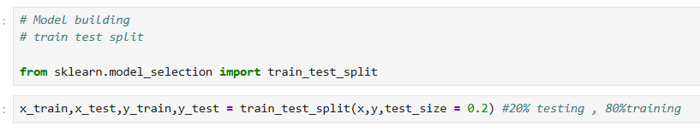
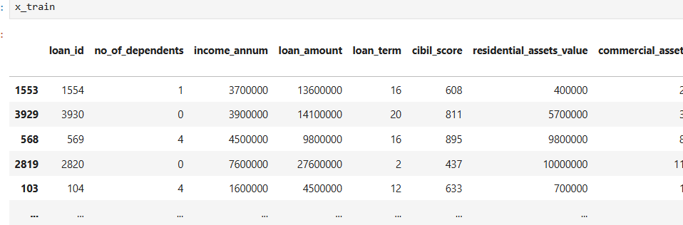
PHASE III

Slide 26


RESULT EVALUATION
04

Slide 27
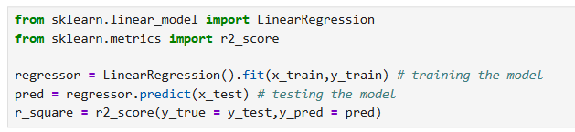
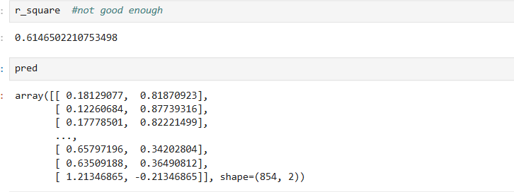
PHASE IV

Slide 28
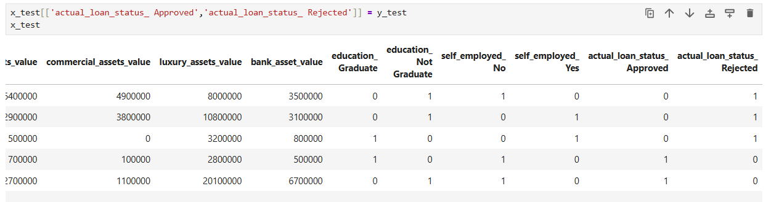
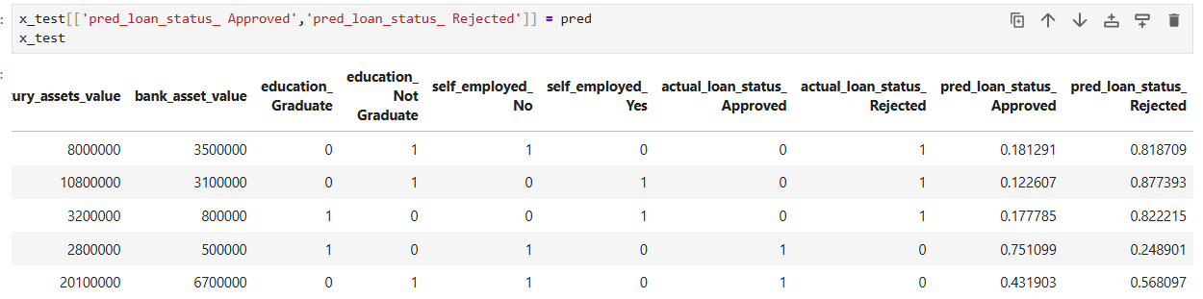

Slide 29
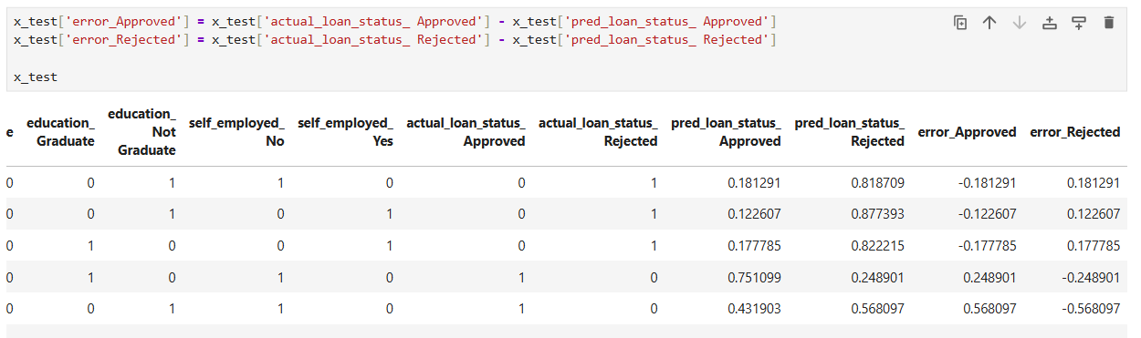
FINAL OUTPUT

Slide 30


0.6146%
An R² score of 0.6146 means our model explains about 61% of the variance in the target variable.

Slide 31



INTERPRETATION:
It’s a moderate-to-good fit, indicating the model captures a reasonable portion of the variation but leaves around 39% unexplained.
For financial or loan prediction datasets, where human behavior and external factors introduce high variability, this is often acceptable.

Slide 32
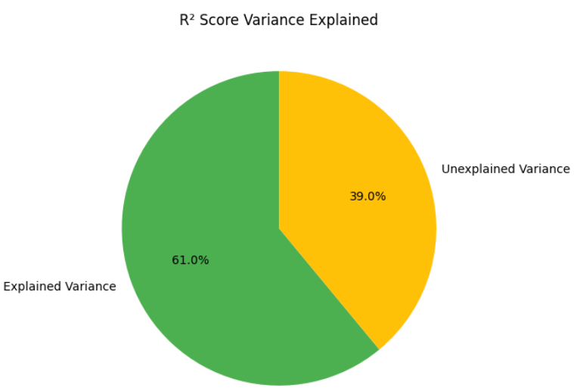
KPI DASHBOARD
The yellow slice (39%) represents the variance not captured by the model.
Unexplained Variance
39%
The green slice (61%) represents the portion of variance model explains.
Explained Variance
61%

Slide 33



THANK YOU
Connect with me…
kinjal.gohil2204@gmail.com

